Slide 1
LEGAL CLAUSE EXTRACTION USING TEXT GENERATION MODELS
Vanellsa Acha

Slide 2
Introduction/Motivation
Legal contract analysis is complex and high-stakes
Traditional NLP models struggle with domain-specific legal language
Reframe clause extraction as a text generation task with generative models (T5, BART, FLAN-T5).
Using CUAD dataset: 13,000+ clauses across 41 categories

Slide 3
From Extractive QA to Generative Models
Traditional models rely on span prediction (e.g., BERT, RoBERTa)
Generative models reframe clause extraction as text generation Allows flexibility for long, multi-sentence, or implicit clauses
CUAD has start tokens only. Discontiguous answer tokens
Evaluated: T5, FLAN-T5, BART with fusion-based architecture

Slide 4
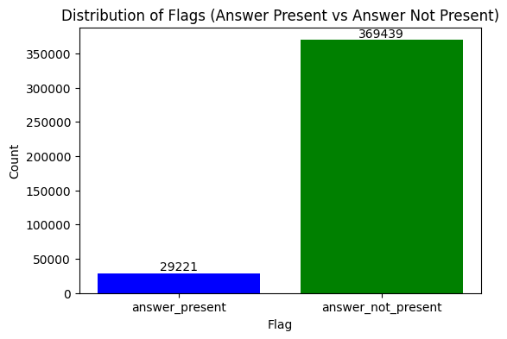
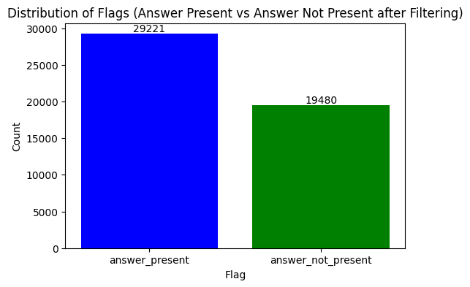
CUAD Dataset: Challenges & Strategy
Long contract pages and word length with sparse clause distribution
Contract length 9-36 pages per clause
Preprocessing: Chunking with sliding windows (512 tokens, 256 overlap). Question context chunking per clause.
Data imbalance in full CUAD dataset and chunked dataset
Under-sampling “No answer” for effective training

Slide 5
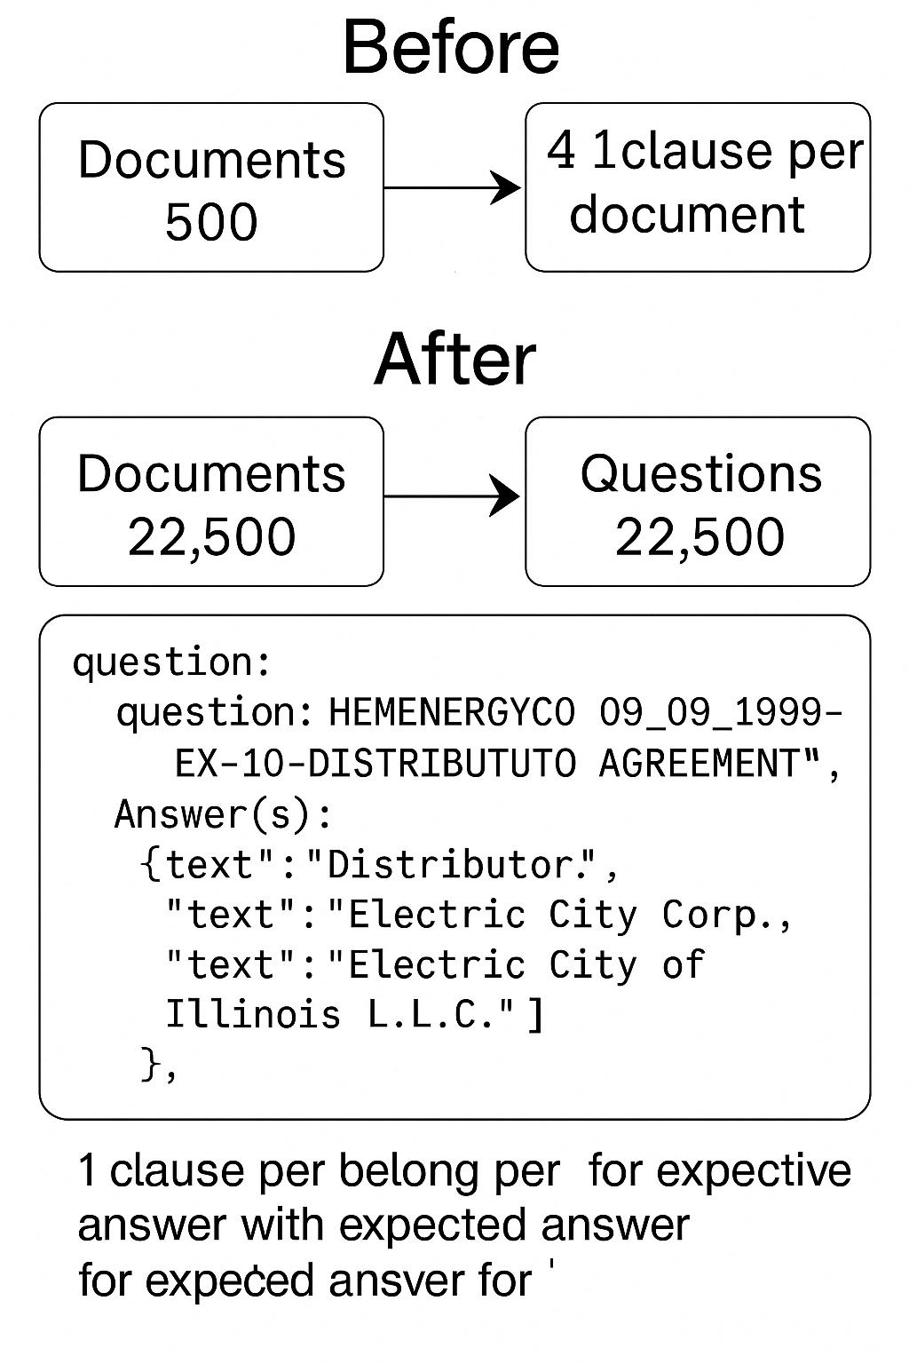
Restructured Dataset Before Chunking

Slide 6
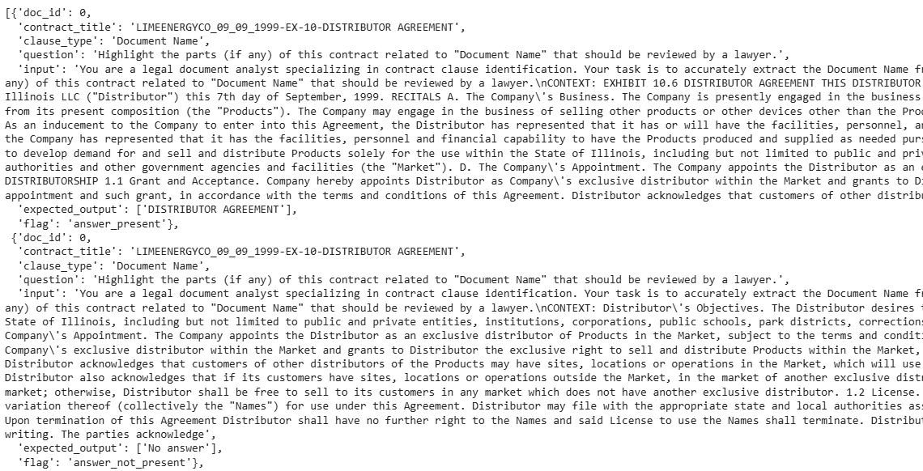
Final Dataset

Slide 7
Models Trained
Model 1 - T5 small as Baseline
Fine-tuned on CUAD with question-context-answer triplets
Trained for 5 epochs using cross-entropy loss
Tended to over-predict “No answer,” especially on subtle clause types
No additional supervision or filtering applied
Model 2 - Flan T-5 base
Instruction-tuned model trained with the same triplets as T5
Better aligned with prompt-style inputs; reduced hallucinations
Showed improved exact match and clause boundary sensitivity
Often abstained when uncertain, reducing false positives

Slide 8
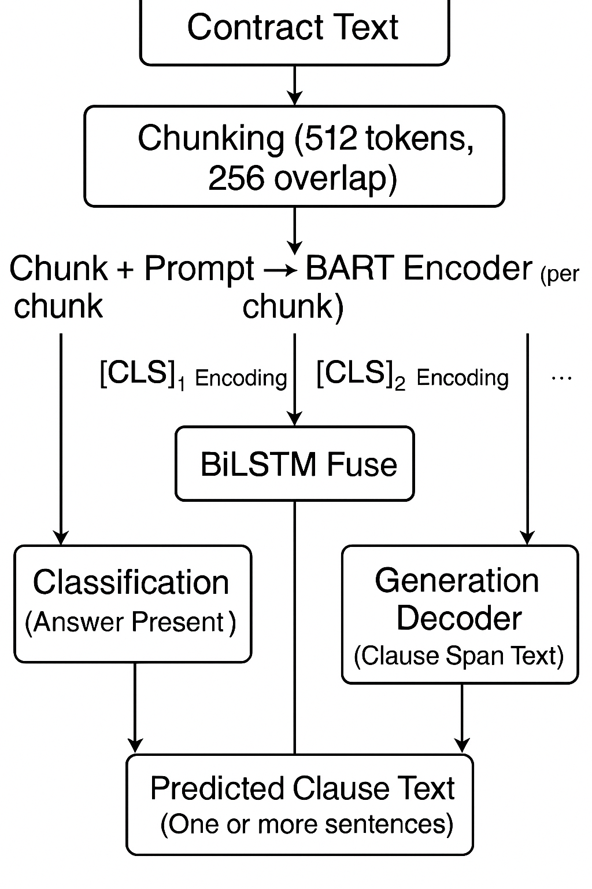
Model 3 - BART Fusion (Generative + Filtering Hybrid) Models Trained cont.
Fusion architecture: Augmented with a clause-type classifier that operates in parallel with the generation process.
Chunk-level evidence filtering: The classifier outputs confidence scores for predicted clause categories. These scores are then used to filter and validate generated clauses.
Post-processing logic: During inference, generated chunks are accepted only if they align with classifier-supported clause types or surpass a predefined confidence threshold.
Goal: Reduce false positives from the generative model and improve clause-level recall without compromising on extraction precision.

Slide 9
Model Evaluation: What determines success?
Evaluation at two levels: (F1, EM, ROUGE, Jaccard similarity, chunk and doc accuracy %)
Chunk level evaluation -
Measures how well the model extracts the correct clause within each individual text segment (chunk).
Reflects clause localization and generation quality at the micro level.
Document level evaluation -
Measures whether the model can correctly assemble and identify the full clause from all relevant chunks in the document.
Reflects the model’s holistic understanding and ability to recover fragmented or scattered clauses.

Slide 10
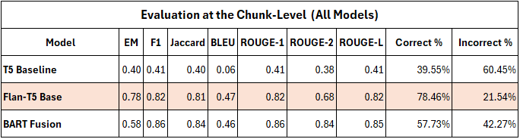
Evaluation at the Chunk Level

Slide 11
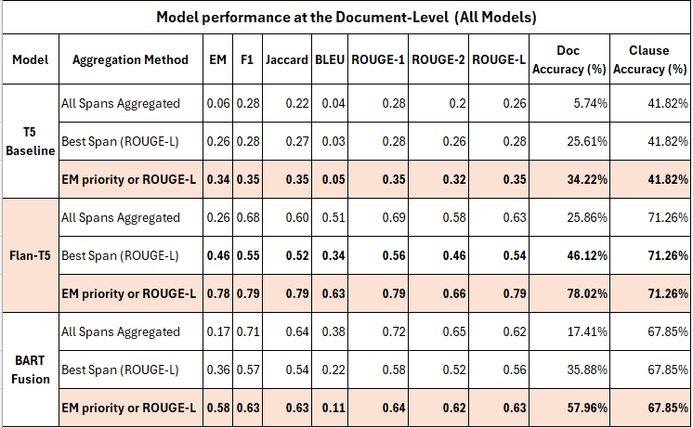
MODEL PERFORMANCE
Document level evaluation (3 Approaches)
Combine all answers
Select best answer by Rouge L
Select best answer by EM if not Rouge L

Slide 12
Model Comparison & Key Findings
T5: Struggled with subtle references, over-predicted "No answer"
FLAN-T5: Better clause fidelity, fewer hallucinations. The encoder lacks cross-chunk relational reasoning; limiting its capacity to track semantic threads across overlapping windows
BART + Fusion: Best for long, fragmented clauses, but hallucination risk. Classification layer reduced noise.
Consistent struggle with similar legal language across clause types
the activation functions (GeLU/Swish) in deeper layers struggle to encode subtle semantic distinctions like legal nuances.

Slide 13
Findings
Dataset was the biggest improvement for baseline and iterative model learning
Generative models show promise for nuanced clause extraction
Instruction tuning (FLAN-T5) improves reliability and fluency
Future directions: Explore Flan-T5 and cross-clause reasoning, better prompts
BART Fusion and FLAN-T5 can be used to complement each other.
Paving the way for semi-automated legal contract review
Contract structure more important than balance.

